Slide 1
POWER BI PROJECT
INSURANCE CLAIMS
ANALYSIS DASHBOARD
Power BI Dashboard & Business Insights
Power BI
DAX
Power Query
Data Modeling
Organisation
BLUE KWET
Prepared by
Sukannia Suresh
Notes:
Good [morning/afternoon] everyone. Today I'm walking you through my Power BI project, the Insurance Claims Analysis Dashboard. The goal of this project was to take raw insurance claims data and turn it into an interactive dashboard that helps management understand claims performance, financial exposure, and risk — all in one place. I built this end-to-end: cleaning and shaping the data in Power Query, modeling it into a proper data model, writing DAX measures for the KPIs, and then designing three report pages that each answer a specific business question. Key message to remember: this isn't just a set of charts — it's a decision-support tool built around real business questions.

Slide 2
THE GOAL
PROJECT OBJECTIVE
“To analyze insurance claims performance, financial exposure, and risk-related patterns using an interactive Power BI dashboard and translate the analysis into actionable business insights.”
ONE OBJECTIVE, THREE ANALYTICAL AREAS
1
2
3
Claims Performance
Financial & Policy Analysis
Risk, Fraud & Settlement Analysis
What is happening with claims across volume, status, and time?
What is the financial impact across policies and branches?
Where are the risk and operational concerns?
INSURANCE CLAIMS ANALYSIS DASHBOARD
2
Notes:
The whole project sits under one single objective — I didn't want three disconnected mini-projects, I wanted one story told in three chapters. I picked these three analytical areas because together they cover the full lifecycle of a claim: first, what's actually happening operationally — how many claims, what status they're in. Second, what that means financially — premiums collected versus claims paid out. And third, where the risk sits — fraud flags, claims needing investigation, and how efficiently we're settling them. Key message: one objective, three connected lenses on the same claims data.

Slide 3
WHY THIS PROJECT
BUSINESS PROBLEM
Raw insurance claims data is large, transactional, and spread across many fields. In its raw form, it makes it difficult to quickly understand:
1
Overall claim performance
4
Financial exposure
Is the book of claims growing, shrinking, or holding steady?
How much money is actually at stake across policies and branches?
2
Claim status and approval patterns
5
Fraud and investigation patterns
How many claims are approved, rejected, or still pending?
Which claims carry elevated risk or need a closer look?
3
Monthly and branch-level claim trends
6
Settlement efficiency
Where and when is claim activity concentrated?
How quickly are claims being resolved?
“How can insurance claims data be transformed into actionable insights for better claims management?”
INSURANCE CLAIMS ANALYSIS DASHBOARD
3
Notes:
Before Power BI, this data just sat in raw transactional form — thousands of rows of claim records with no easy way to see the big picture. You couldn't quickly tell how claims were trending month to month, which branches were busiest, how much money was actually at stake, or where fraud and investigation flags were concentrated. That's the real business problem — not a lack of data, but a lack of a fast, visual way to interpret it. That naturally leads to the question this whole dashboard is built to answer: how do we turn this raw data into insights the claims team can actually act on? Key message: the problem was visibility, not data volume.

Slide 4
FOUNDATION
DATA MODEL & PREPARATION
Dim_Date
DATA PREPARATION & MODELING
✓
Cleaned & shaped Raw claims data cleaned and transformed in Power Query before loading.
Dim_Policy
✓
Star schema Fact_Claims connected to four dimension tables: Dim_Date, Dim Branch, Dim_Customer, Dim_Policy.
Fact_Claims
✓
Dedicated date table Dim_Date supports month/year slicers and time-based trend analysis.
Dim_Customer
✓
Relationships One-to-many relationships built from each dimension into Fact_Claims.
Dim Branch
DAX measures Measures created for the core KPIs — Total Claims, Total Claim Amount, Approval Rate, Fraud Claims, Claim-to-Premium Ratio, and Average Settlement Days — used consistently across all three pages.
✓
STAR SCHEMA — ONE FACT TABLE, FOUR DIMENSIONS
INSURANCE CLAIMS ANALYSIS DASHBOARD
4
Notes:
Before I could build any visuals, I had to get the data model right. I used Power Query to clean and shape the raw claims data, then modeled it as a star schema — a single fact table, Fact_Claims, connected to four dimension tables: Dim_Date, Dim Branch, Dim_Customer, and Dim_Policy. The dedicated date table is what powers the year and month slicers and lets me do proper trend analysis. On top of that model, I wrote DAX measures for every KPI you'll see across the three pages — Total Claims, Total Claim Amount, Approval Rate, Fraud Claims, Claim-to-Premium Ratio, Average Settlement Days — so the numbers stay consistent no matter which page you're on. Key message: a clean, well-related data model is what makes the whole dashboard reliable and fast.

Slide 5
THE STORY
FROM DATA TO BUSINESS INSIGHTS
Claims Performance
“What is happening?”
1
↓
Financial & Policy Analysis
“What is the financial impact?”
2
↓
Risk, Fraud & Settlement
“Where are the risks and operational concerns?”
3
↓
Business Recommendations
“What should management focus on?”
4
INSURANCE CLAIMS ANALYSIS DASHBOARD
5
Notes:
Before I show you the actual dashboard pages, I want to set up the story, because I don't want this to feel like a random collection of charts. Each of the three report pages answers one specific business question in sequence — first what's happening, then what it costs, then where the risk sits — and that naturally leads to recommendations for management. Key message: the dashboard was designed around this exact flow, not the other way around.

Slide 6
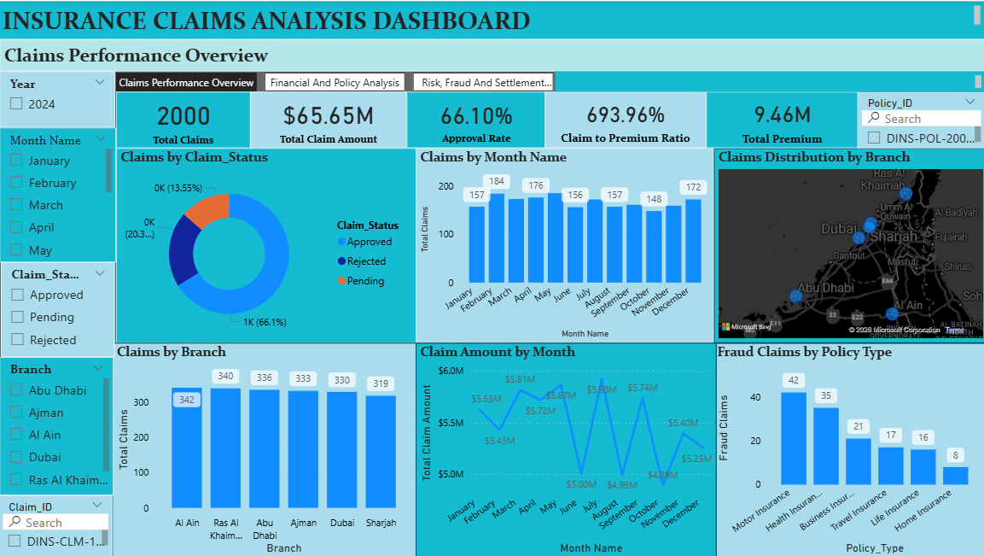
DASHBOARD PAGE 1 OF 3
1. CLAIMS PERFORMANCE OVERVIEW
“WHAT IS HAPPENING WITH CLAIMS?”
HOW THE VISUALS ANSWER THIS
Total Claims · Total Claim Amount · Approval Rate
Three headline cards anchor the page — the overall scale and outcome rate of the claims book at a glance.
Claims by Claim Status
Donut chart splitting claims into approved, rejected and pending — the outcome mix behind the approval rate.
▤ INSERT DASHBOARD SCREENSHOT
CLAIMS PERFORMANCE OVERVIEW — full page view
Monthly Claim Volume · Monthly Claim Amount
Combo and line charts trending claim count and claim value by month to surface seasonality.
Claims by Branch · Claims Distribution by Branch
Column chart and map showing where claim volume is concentrated across branches.
Fraud Claims by Policy Type
An early risk signal placed on the overview page, explored in full on the Risk page.
INSURANCE CLAIMS ANALYSIS DASHBOARD
6
Notes:
This first page answers the most basic operational question: what's actually happening with our claims right now? The three cards at the top — Total Claims, Total Claim Amount, and Approval Rate — give an instant scale check. Then the status donut breaks that down into approved, rejected and pending, so you immediately see the outcome mix behind the headline approval rate. The monthly trend and branch charts let you see whether that volume is steady or spiking, and where it's coming from geographically. And I included a fraud-by-policy-type view here too, as an early flag, before diving deeper into it on the Risk page. Key message: this page is the operational pulse check — volume, outcome, timing and location, all in one view.

Slide 7
PAGE 1 TAKEAWAYS
WHAT DID WE LEARN FROM CLAIMS PERFORMANCE?
Volume & Financial Scale
Claim Outcome Mix
WHAT
WHAT
2,000 total claims processed, totaling $65.65M in claim amount.
1,322 approved (66.10% approval rate), 407 rejected, 271 pending.
SO WHAT
SO WHAT
Claims processing operates at meaningful scale, with substantial dollars flowing through the pipeline.
Roughly two in three claims are approved. Pending claims are a sizeable group still awaiting resolution.
BUSINESS IMPLICATION
BUSINESS IMPLICATION
Even small shifts in approval or fraud rates translate into a significant dollar impact.
Pending claims represent unresolved workload — a queue that needs active monitoring, not just approvals and rejections.
Monthly & Branch Distribution
Fraud Signal by Policy Type
WHAT
WHAT
[VERIFY FROM DASHBOARD] — exact monthly and branch concentration should be read directly off the dashboard filters.
Fraud Claims by Policy Type is visible on this page as an early indicator (see Risk page for the full breakdown).
SO WHAT
SO WHAT
[VERIFY FROM DASHBOARD] — confirm whether volume is seasonal or concentrated in specific branches.
Fraud is not evenly distributed across the claims book — it clusters by policy type.
BUSINESS IMPLICATION
BUSINESS IMPLICATION
Any confirmed concentration should inform staffing and monitoring priorities at the branch or month level.
This overview signal is the reason a dedicated Risk, Fraud & Settlement page was built.
INSURANCE CLAIMS ANALYSIS DASHBOARD
7
Notes:
So what did this page actually tell us? First, scale — 2,000 claims worth $65.65 million shows this is a real financial exposure, not a rounding error. Second, the outcome split — about two-thirds of claims get approved, but the pending bucket of 271 claims is worth watching closely since that's unresolved work sitting in the pipeline. For the monthly and branch patterns, I'm being careful here — I want you to read the specific concentration directly off the dashboard rather than me quoting a number I can't fully verify from this summary. And the fraud-by-policy-type chart on this page is really a preview — it's the reason I built a dedicated risk page. Key message: strong overall approval rate, but a meaningful pending queue and a fraud signal both warrant follow-up.

Slide 8
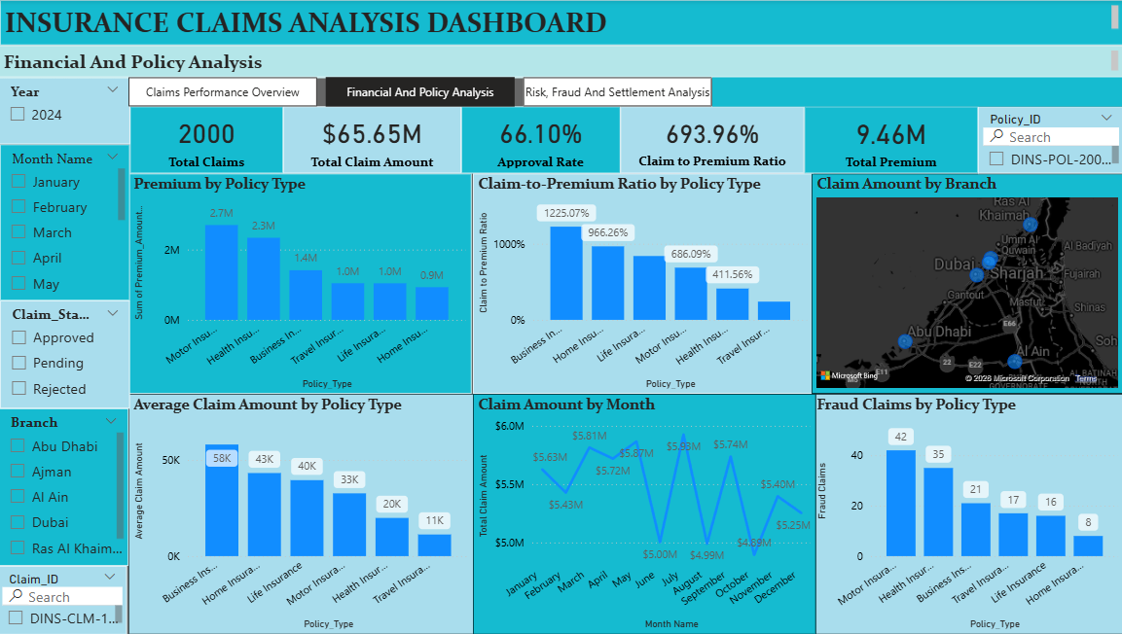
DASHBOARD PAGE 2 OF 3
2. FINANCIAL & POLICY ANALYSIS
“WHAT IS THE FINANCIAL IMPACT OF CLAIMS ACROSS POLICIES AND BRANCHES?”
HOW THE VISUALS ANSWER THIS
Premium by Policy Type
Shows the premium revenue base collected across each policy type — the income side of the equation.
Claim-to-Premium Ratio by Policy Type
Compares claims paid out against premium collected per policy type — a direct read on cost efficiency.
▤ INSERT DASHBOARD SCREENSHOT
FINANCIAL & POLICY ANALYSIS — full page view
Average Claim Amount by Policy Type
Highlights claim severity — how large a typical claim is within each policy type.
Claim Amount by Branch
Map view of financial exposure by branch, alongside monthly claim amount trend.
Fraud Claims by Policy Type
Overlays the risk lens onto the financial view — flags where financial exposure and fraud risk intersect.
INSURANCE CLAIMS ANALYSIS DASHBOARD
8
Notes:
This page shifts the question from "what's happening" to "what does it cost." Premium by Policy Type shows the revenue side — what's coming in. The Claim-to-Premium Ratio is really the key visual here, because it tells you directly whether a policy type is paying out more relative to what it collects. Average Claim Amount by Policy Type adds severity on top of that — not just how often claims happen, but how large they are. The branch map and monthly trend bring in geography and time, and I repeated the fraud-by-policy-type chart here so the financial and risk views sit side by side. Key message: this page connects premium income to claim payout, policy type by policy type.

Slide 9
PAGE 2 TAKEAWAYS
WHAT DID WE LEARN FROM FINANCIAL & POLICY ANALYSIS?
Premium contribution by policy type
OBSERVATION: Premium by Policy Type shows how much revenue each policy type contributes. IMPLICATION: [VERIFY FROM DASHBOARD] — confirm the actual premium split before naming a leading policy type.
Claim-to-premium relationship
OBSERVATION: The Claim-to-Premium Ratio compares payout against income per policy type. IMPLICATION: A ratio approaching or exceeding 1 signals a policy type paying out close to (or more than) what it collects — worth flagging for pricing review. Confirm which policy types this applies to from the dashboard.
Average claim severity
OBSERVATION: Average Claim Amount by Policy Type shows typical claim size per policy type. IMPLICATION: [VERIFY FROM DASHBOARD] — higher-severity policy types warrant closer reserve and underwriting attention.
Branch-level financial exposure
OBSERVATION: Claim Amount by Branch maps where claim value is concentrated geographically. IMPLICATION: [VERIFY FROM DASHBOARD] — branch-level exposure should guide where financial oversight is tightened.
Monthly claim amount trend
OBSERVATION: Monthly Claim Amount tracks how total claim value moves across the year. IMPLICATION: A rising or volatile trend affects cash-flow and reserve planning; a stable trend supports predictable budgeting.
INSURANCE CLAIMS ANALYSIS DASHBOARD
9
Notes:
Five things came out of the financial and policy page. Premium by policy type tells us where revenue is coming from, but I want to confirm the exact split against the dashboard before I name a specific top policy type in front of you. The claim-to-premium ratio is the one to watch closely — any policy type where that ratio gets close to or above 1 means we're paying out nearly as much as, or more than, we're collecting, which is a pricing conversation. Average claim severity and branch exposure both need a live look at the dashboard to call out specifics accurately, and the monthly trend tells us whether our financial exposure is stable or volatile, which matters for reserve planning. Key message: the claim-to-premium ratio is the single most important financial health metric on this page.

Slide 10
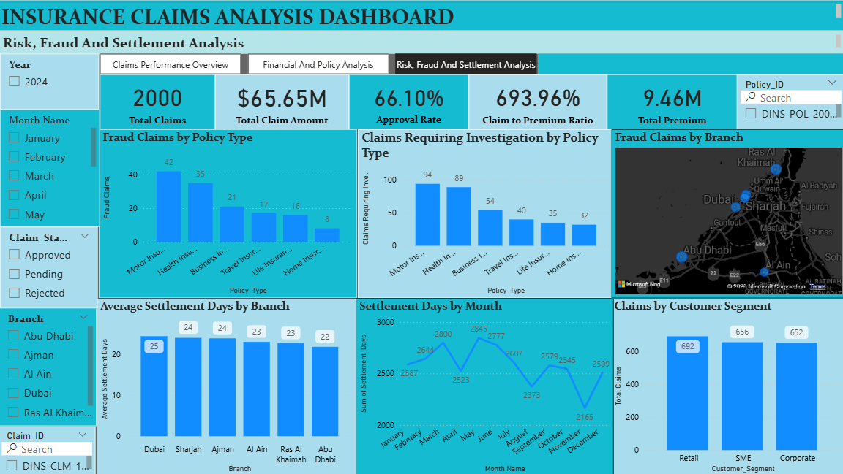
DASHBOARD PAGE 3 OF 3
3. RISK, FRAUD & SETTLEMENT ANALYSIS
“WHERE ARE THE KEY RISK AND OPERATIONAL CONCERNS?”
HOW THE VISUALS ANSWER THIS
Fraud Claims by Policy Type
Shows where confirmed fraud-flagged claims concentrate across policy types.
Claims Requiring Investigation by Policy Type
A separate, broader flag — cases requiring further review, not confirmed fraud.
▤ INSERT DASHBOARD SCREENSHOT
RISK, FRAUD & SETTLEMENT ANALYSIS — full page view
Fraud Claims by Branch
Map view of fraud-flagged claims by branch location.
Average Settlement Days by Branch · Settlement Days by Month
Tracks how efficiently claims are settled, by branch and over time.
Claims by Customer Segment
Breaks claim volume down by customer segment for a demographic view of risk.
INSURANCE CLAIMS ANALYSIS DASHBOARD
10
Notes:
This third page is where we look at risk and operations. It's important to separate two very different flags: Fraud Claims by Policy Type shows confirmed fraud, while Claims Requiring Investigation by Policy Type shows cases flagged for further review — those are not the same population. The branch map adds a geographic lens to fraud, and the settlement charts — by branch and by month — track operational efficiency, essentially how long it takes us to close a claim. I also added claims by customer segment, to see whether claim volume skews toward particular types of customers. Key message: this page separates confirmed risk from things that just need a closer look, and adds an operational efficiency lens on top.

Slide 11
PAGE 3 TAKEAWAYS
WHAT DID WE LEARN ABOUT RISK & OPERATIONS?
139
Fraud Claims
(confirmed flags)
344
Investigation Required
(flagged for review)
23.41
Avg Settlement Days
Fraud Claims (confirmed) ≠ Investigation Required (flagged for review) — these are two distinct populations.
1
Fraud by policy type / branch — [VERIFY FROM DASHBOARD] — read the specific policy type / branch concentration directly from the charts before naming a leading category.
2
Investigation requirements — 344 claims are flagged as requiring investigation — a broader operational review queue, separate from confirmed fraud.
3
Settlement performance — Average settlement time is 23.41 days — a useful baseline operational KPI to track by branch and month.
4
Customer segment distribution — [VERIFY FROM DASHBOARD] — confirm which customer segments carry the largest claim share.
INSURANCE CLAIMS ANALYSIS DASHBOARD
11
Notes:
Two numbers here need to be kept clearly separate: 139 fraud claims are confirmed flags, while 344 claims require investigation — that's a much broader group of cases pulled aside for a closer look, not a confirmation of wrongdoing. I'd want to look at the live dashboard with you to name the specific policy type or branch where fraud concentrates, rather than guessing from memory. The one number I'm confident quoting is average settlement time — 23.41 days — which is a solid operational baseline we can track going forward, by branch and by month, to see if we're getting faster or slower. Key message: don't conflate fraud with investigation-required — they need different responses, and settlement time is our clean operational KPI.

Slide 12
USER EXPERIENCE
INTERACTIVE DASHBOARD FEATURES
Year Slicer
Month Slicer
Branch Slicer
Claim Status Slicer
Y
M
B
S
Claim ID Lookup
Policy ID Lookup
Page Navigation
Q&A
#
P
→
?
These controls let users investigate the data for themselves — filtering by year, month, branch or claim status, looking up an individual Claim ID or Policy ID, moving between pages, or asking natural-language questions with Q&A — rather than only viewing static, pre-set charts.
INSURANCE CLAIMS ANALYSIS DASHBOARD
12
Notes:
One thing I wanted to emphasize is that this isn't a static report — it's interactive. Every page has slicers for year, month, branch and claim status, so anyone can filter down to exactly the slice they care about. There's also a Claim ID and Policy ID lookup, so if someone needs to investigate one specific case, they don't have to scroll through the whole dataset — they can search directly. Page navigation moves between the three analytical pages, and Q&A lets users type a natural-language question and get an answer straight from the model. Key message: this turns the dashboard from a static report into a self-serve investigation tool.

Slide 13
CONNECTING THE PAGES
KEY FINDINGS ACROSS THE ANALYSIS
CLAIMS PERFORMANCE
FINANCIAL EXPOSURE
RISK & OPERATIONS
What is happening?
Where is the financial impact?
Where are the risks and operational concerns?
STRONGEST SUPPORTED INSIGHT
STRONGEST SUPPORTED INSIGHT
STRONGEST SUPPORTED INSIGHT
2,000 claims totaling $65.65M, with a 66.10% approval rate (1,322 approved / 407 rejected / 271 pending).
$65.65M in total claim amount is examined against premium collected, by policy type and branch — see the claim-to-premium ratio for the clearest cost signal. [VERIFY FROM DASHBOARD] for the leading policy type/branch.
139 confirmed fraud claims and 344 claims flagged for investigation are tracked separately, against an average settlement time of 23.41 days.
Read together, these three pages tell one continuous story: claims volume and outcomes (performance), what that volume costs relative to premium (exposure), and where risk and operational attention are needed (risk & operations).
INSURANCE CLAIMS ANALYSIS DASHBOARD
13
Notes:
This slide is where I pull the three pages back together, because on their own they can feel like separate reports. Claims performance tells us the scale and outcome mix: 2,000 claims, $65.65 million, a 66.10% approval rate. Financial exposure builds on that by asking what it's costing us relative to premium — the claim-to-premium ratio is the clearest signal there, and I'd confirm the specific leading policy type or branch on the live dashboard. And risk & operations closes the loop with 139 confirmed fraud claims, 344 flagged for investigation, and a 23.41-day average settlement time. Key message: these three pages are one continuous story — volume, then cost, then risk — not three separate reports.

Slide 14
WHAT SHOULD HAPPEN NEXT
FROM INSIGHTS TO ACTION
1
Monitor pending claims to reduce unresolved workload.
5
Track settlement time as an operational KPI.
Linked to 271 pending claims identified in Claims Performance.
Linked to 23.41-day average settlement time.
2
Review rejection patterns to understand claim outcome drivers.
6
Continue branch-level monitoring for unusual claim concentration.
Linked to 407 rejected claims within the outcome mix.
Linked to branch-level distribution across all three pages.
3
Prioritize investigation-required claims for timely review.
7
Use Claim ID and Policy ID lookup for faster case-level investigation.
Linked to 344 claims flagged for investigation.
Linked to interactive lookup features on every page.
4
Monitor fraud patterns by policy type and branch.
Linked to 139 confirmed fraud claims across the book.
INSURANCE CLAIMS ANALYSIS DASHBOARD
14
Notes:
Everything on this slide traces back to something we just saw. Because pending claims showed up as a sizeable group, the first recommendation is to actively monitor and reduce that backlog. Because rejections make up a meaningful share of outcomes, we should understand what's driving them. Investigation-required claims and fraud patterns both came out of the risk page, so those get prioritized and monitored by policy type and branch. Settlement time becomes an ongoing operational KPI since we now have a clean baseline of 23.41 days, and branch-level monitoring plus the ID lookup tools support faster day-to-day investigation. Key message: every recommendation here is traceable back to a specific insight — nothing is generic advice.

Slide 15
IMPACT
BUSINESS VALUE OF THE DASHBOARD
Faster monitoring
Better claims visibility
Financial exposure analysis
Risk identification
1
2
3
4
Investigation prioritization
Settlement monitoring
Case-level investigation
Management decision-making
5
6
7
8
The dashboard supports faster, more consistent monitoring of claims activity — it doesn't replace investigation or underwriting judgment, but it makes the underlying data far easier to see and act on.
INSURANCE CLAIMS ANALYSIS DASHBOARD
15
Notes:
Stepping back, here's the practical value this dashboard adds day to day: faster monitoring, better visibility into claims, a clear read on financial exposure, and a dedicated lens on risk and fraud. It also helps prioritize which investigation-required claims to look at first, tracks settlement performance, and supports quick case-level lookups by Claim ID or Policy ID. I want to be careful not to oversell this — the dashboard supports better, faster decisions, but the judgment calls still sit with the claims and risk teams. Key message: this is a decision-support tool, not a replacement for expert judgment.

Slide 16
CONCLUSION
RAW DATA
→
CLAIMS
PERFORMANCE
→
FINANCIAL
IMPACT
→
RISK &
OPERATIONS
→
ACTIONABLE
INSIGHTS
“The dashboard transforms insurance claims data into an interactive decision-support tool by connecting claims performance, financial exposure, and risk analysis in one report.”
Sukannia Suresh · Insurance Claims Analysis Dashboard · Power BI, DAX, Power Query, Data Modeling
Notes:
To close — this project took raw insurance claims data, structured it into a proper model in Power BI, and then answered three connected business questions: what's happening with claims, what's the financial impact, and where are the risks and operational concerns. Each answer fed into a set of concrete, traceable recommendations rather than generic advice. The one-line takeaway I want you to leave with is this: this dashboard connects claims performance, financial exposure, and risk analysis into a single interactive tool that supports faster, better-informed claims management decisions. Thank you — happy to open it up and walk through any page live, or take questions.

Slide 17
Thank You
Questions & Discussion
INSURANCE CLAIMS ANALYSIS DASHBOARD
15
Notes:
"Thank you for your time - I'm happy to answer any questions about the data preparation, the PivotTables, the dashboard design, or the insights I found."

