Slide 1
INTERNSHIP PROJECT
Banking Customer Satisfaction
Dashboard
Interactive Complaint Analysis using Microsoft Excel
Organisation
BLUE KWET
Presented by
Sukannia Suresh
Banking Customer Satisfaction Dashboard
1
Notes:
"Good [morning/afternoon]. I'm Sukannia Suresh, and I'll be presenting my internship project - the Banking Customer Satisfaction Dashboard, built in Microsoft Excel. This project analyzes 1,200 real customer complaint records to help a banking operations team understand complaint patterns, resolution performance, and customer satisfaction. I'll walk you through the business problem I identified, how I prepared and analyzed the data, what I found, and how it can support better operational decisions."

Slide 2
PROJECT OVERVIEW
What This Project Analyzes
The dataset contains 1,200 banking customer complaint records. This project analyzes seven areas of complaint performance:
1
2
3
4
Complaint Volume
Resolution Status
Complaint Types
Complaint Channels
5
6
7
Customer Ratings
Resolution Time
Monthly Trends
Banking Customer Satisfaction Dashboard
2
Notes:
"This project is built on 1,200 real banking customer complaint records. Rather than just describing the dataset, I structured the whole project around seven specific areas: complaint volume, resolution status, complaint types, complaint channels, customer ratings, resolution time, and monthly trends. Each of these became its own focused piece of analysis later in the presentation - I wasn't just building charts, I was trying to answer a specific question with each one."

Slide 3
BUSINESS PROBLEM & OBJECTIVES
Business Problem & Project Objectives
Raw complaint data does not immediately show where operational attention is required.
1
2
3
Understand the overall complaint and resolution status
Identify the most frequent complaint types and channels
Analyze customer satisfaction through ratings
4
5
6
Analyze complaint trends over time
Identify complaint categories with longer resolution times
Build an interactive dashboard for dynamic analysis
Banking Customer Satisfaction Dashboard
3
Notes:
"Before opening Excel, I defined the actual business problem: raw complaint data doesn't immediately show where operational attention is needed - it's just rows in a spreadsheet until someone structures it. So I set six objectives to guide the project: understand overall complaint and resolution status, identify the most frequent complaint types and channels, analyze customer satisfaction through ratings, analyze trends over time, identify which complaint categories take longer to resolve, and build an interactive dashboard so this analysis stays useful, not just a one-time report. Every slide that follows maps back to one of these six objectives."

Slide 4
DATA PREPARATION & METHODOLOGY
From Raw Data to Interactive Dashboard
Raw
Data
Validation &
Cleaning
Calculated
Fields
Excel
Table
Pivot
Tables
Pivot
Charts
KPIs
Slicers +
Timeline
Interactive
Dashboard
VALIDATION FUNCTIONS USED
RESOLUTION TIME CALCULATION
ISBLANK
ISERROR
ISNUMBER
Resolution Time (Hours) =
(Resolution Date − Complaint Date) × 24
ISTEXT
TEXT
YEAR
This calculated field made it possible to measure how long each complaint took to resolve, in hours, for every record in the dataset.
Banking Customer Satisfaction Dashboard
4
Notes:
"This is the workflow I followed: raw data, validation and cleaning, calculated fields, an Excel Table, PivotTables, PivotCharts, KPIs, and finally slicers and a timeline to make the dashboard interactive. For validation, I used ISBLANK to catch missing values, ISERROR to catch broken formulas, ISNUMBER and ISTEXT to confirm fields held the right data type, TEXT for consistent formatting, and YEAR to support date-based analysis. The one calculated field that mattered most was Resolution Time in Hours, worked out as the resolution date minus the complaint date, multiplied by 24. That single column is what made the resolution-time analysis possible later in this presentation."

Slide 5
OBJECTIVE 1
Complaint Resolution Status
OBJECTIVE
ANALYSIS
RESULT
Understand the current resolution status of complaints.
Counted complaints by Resolution_Status using a PivotTable.
Resolved 783 · In Progress 241 · Pending 176
783
Resolved ≈ 65%
241
In Progress ≈ 20%
176
Pending ≈ 15%
INSIGHT
417 complaints are still either pending or in progress.
Banking Customer Satisfaction Dashboard
5
Notes:
"My first objective was to understand where complaints stand today. About 65% of complaints, 783, are resolved. 20%, or 241, are still in progress, and 15%, 176, are pending. That's a healthy majority resolved, but the insight that matters most here is that pending and in-progress together add up to 417 complaints - more than a third of the entire dataset. So while most complaints do get resolved, there's still a significant unresolved workload that operations should be actively tracking."

Slide 6
OBJECTIVE 2
Complaint Type Distribution
OBJECTIVE
ANALYSIS
RESULT
Identify which complaint types generate the highest volume.
Counted complaints by Complaint_Type using a PivotTable.
Fraud Investigation leads at 165, Account Access lowest at 131.
INSIGHT
Fraud Investigation
has the highest complaint volume with 165 complaints.
Card Problem (161) follows closely, while Account Access (131) sees the fewest complaints.
Banking Customer Satisfaction Dashboard
6
Notes:
"To identify which complaint types generate the most volume, I counted complaints by category using a PivotTable. Fraud Investigation leads at 165 complaints, with Card Problem close behind at 161. Service Delay, Loan Inquiry, Transaction Issue, Online Banking Error, and ATM Issue sit in the mid-140s, and Account Access is the least frequent category at 131. Fraud Investigation isn't just one category among eight - it's the single largest source of complaints, which becomes even more significant when we look at resolution time later."

Slide 7
OBJECTIVE 2
Complaint Channel Analysis
OBJECTIVE
ANALYSIS
RESULT
Identify which channels customers use to raise complaints.
Counted complaints by Channel using a PivotTable.
Email 247 · Website 245 · Branch 243 · Call Center 243 · Mobile App 222
INSIGHT
Complaint volumes are almost evenly distributed across channels
Email ≈21%, Website ≈20%, Branch ≈20%, Call Center ≈20%, and Mobile App ≈19% - no single channel dominates.
BUSINESS IMPLICATION
Complaint-handling quality should remain consistent across all channels rather than focusing on only one.
Banking Customer Satisfaction Dashboard
7
Notes:
"Next, I looked at which channels customers use to file complaints. The distribution is remarkably even: Email leads slightly at 247 complaints, about 21%, followed by Website at 245, Branch and Call Center both at 243, and Mobile App at 222, about 19%. No single channel dominates. The business implication is straightforward: complaint-handling quality and resourcing should stay consistent across all five channels, rather than concentrating improvement efforts on just one."

Slide 8
OBJECTIVE 3
Customer Satisfaction
OBJECTIVE
ANALYSIS
RESULT
Measure customer satisfaction through customer ratings.
Averaged Customer_Rating and counted complaints per rating.
Average rating 3.22/5; 5-star is the largest single category.
AVERAGE RATING
3.22 / 5 ★
5-star ratings are the largest single category (198 responses), but the overall average of 3.22/5 shows there is still considerable room to improve customer satisfaction.
Banking Customer Satisfaction Dashboard
8
Notes:
"For customer satisfaction, I averaged the Customer Rating field and also counted how many complaints fell into each rating band. 5-star is the largest single category, with 198 responses, and 2, 3, and 4-star ratings are each at 158. 1-star is the smallest group at 111. The important insight is that even though 5-star is the biggest individual category, the overall average across all 1,200 complaints is only 3.22 out of 5. That average tells a fuller story than the top category alone - it shows there's still considerable room to improve customer satisfaction."

Slide 9
OBJECTIVE 4
Monthly Complaint Trend
OBJECTIVE
ANALYSIS
RESULT
Identify monthly patterns in complaint volume.
Grouped Complaint_Date by month in a PivotTable and counted complaints.
March highest (117); June lowest (90).
INSIGHT
Highest: March — 117
Lowest: June — 90
Also elevated: August (111), December (110), January (109)
Volume fluctuates rather than trending steadily up or down
Banking Customer Satisfaction Dashboard
9
Notes:
"To find monthly patterns, I grouped Complaint Date by month in a PivotTable and counted complaints per month. March is the peak at 117 complaints, and June is the lowest at 90. August, December, and January are also somewhat elevated, at 111, 110, and 109. The overall insight is that complaint volume fluctuates throughout the year rather than following one consistent upward or downward trend - so I'm not attaching a single cause to these swings, just noting the pattern is there for operations to keep an eye on."

Slide 10
OBJECTIVE 5
Average Resolution Time
OBJECTIVE
ANALYSIS
RESULT
Identify complaint categories requiring longer resolution time.
Averaged Resolution_Time_Hours by Complaint_Type using a PivotTable.
Fraud Investigation longest at 60.86 hrs; overall average 27.70 hrs.
MOST IMPORTANT INSIGHT
Fraud Investigation
has both the highest complaint volume (165) and the longest average resolution time (60.86 hrs) - the strongest combined finding in this analysis.
Banking Customer Satisfaction Dashboard
10
Notes:
"This is one of the most important slides in the whole analysis. I averaged Resolution Time in Hours by complaint type. Fraud Investigation takes the longest by far, at 60.86 hours, well above the overall average of 27.70 hours. Service Delay and Online Banking Error follow at 39.26 and 38.03 hours. ATM Issue, Loan Inquiry, Card Problem, and Account Access are all faster, and Transaction Issue resolves quickest at just 6.95 hours. When I combine this with the complaint-type volume chart from earlier, the finding is clear: Fraud Investigation has both the highest complaint volume and the longest resolution time. That combination makes it the single most important operational area to investigate."

Slide 11
KPI SUMMARY
Executive-Level KPI Summary
1,200
783
176
Total Complaints
Resolved
Pending
241
27.70 hrs
3.22 / 5 ★
In Progress
Avg. Resolution Time
Avg. Customer Rating
These six KPIs give management an executive-level summary of complaint performance at a glance - the same numbers that anchor every chart in this presentation.
Banking Customer Satisfaction Dashboard
11
Notes:
"These six KPI cards bring everything together into an executive-level summary. There are 1,200 total complaints, of which 783 are resolved, 176 are pending, and 241 are in progress. The average resolution time across all complaints is 27.70 hours, and the average customer rating is 3.22 out of 5. Nothing here is new - these are the same numbers from the analysis I've just walked through - but presenting them together like this is what lets a manager get the full picture in about ten seconds."

Slide 12
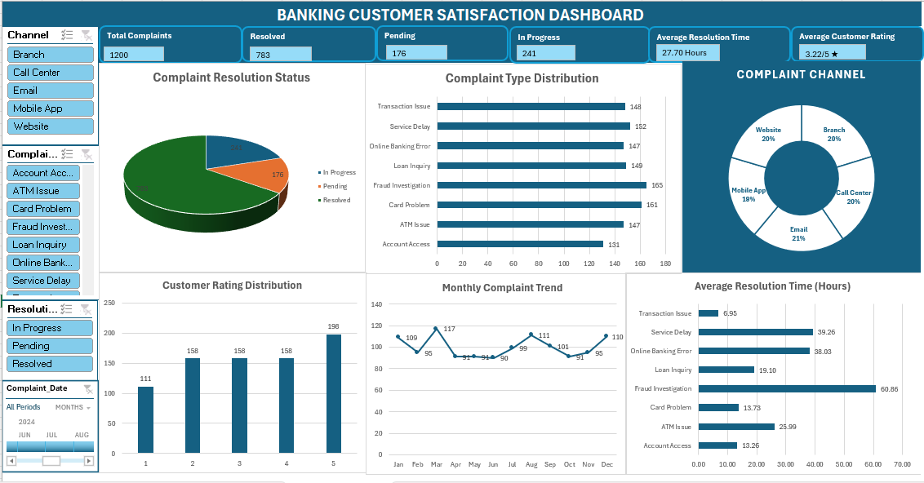
INTERACTIVE DASHBOARD
The Dashboard & How It Works
SLICERS
Channel · Complaint Type · Resolution Status
TIMELINE
Complaint Date
DASHBOARD SCREENSHOT
DYNAMIC KPIs
Six KPI cards, all filter-responsive
Insert the actual Excel dashboard screenshot here
VISUALIZATIONS
Resolution Status
Complaint Type
Complaint Channel
Customer Rating
Monthly Trend
Avg. Resolution Time
Banking Customer Satisfaction Dashboard
12
Notes:
"This is the finished dashboard. [Point to the screenshot as you speak.] Every chart you've seen in this presentation - resolution status, complaint type, complaint channel, customer rating, monthly trend, and average resolution time - lives on this one screen, built entirely from PivotTables and PivotCharts. What makes it interactive is the Channel, Complaint Type, and Resolution Status slicers, plus a timeline on Complaint Date. All of those are connected to the relevant PivotTables, so selecting a filter updates the charts and all six KPI cards together, not just one piece of the dashboard. That's what turns this from a set of static charts into something a manager could actually explore on their own."

Slide 13
KEY BUSINESS INSIGHTS & RECOMMENDATIONS
Insight → Recommended Action
Fraud Investigation has high volume and the longest resolution time.
Prioritize fraud investigation workflows and investigate the causes of delay.
417 complaints are pending or in progress.
Focus on reducing the unresolved backlog.
Average customer rating is 3.22/5.
Identify factors contributing to lower satisfaction and improve customer experience.
Complaint volumes are almost evenly distributed across channels.
Maintain consistent service quality across all complaint channels.
Monthly complaint volume fluctuates.
Monitor periods with higher complaint volumes.
Banking Customer Satisfaction Dashboard
13
Notes:
"Bringing the analysis together into practical recommendations. Fraud Investigation has both high volume and the longest resolution time, so my recommendation is to prioritize fraud investigation workflows and look into the causes of delay. 417 complaints are pending or in progress, so the backlog needs active reduction. The average customer rating of 3.22 out of 5 means the bank should identify what's driving lower satisfaction and work to improve it. Complaint volumes are evenly spread across channels, so service quality should stay consistent everywhere rather than being concentrated on one channel. And since monthly complaint volume fluctuates, operations should keep monitoring higher-volume periods as they occur. Every recommendation here ties directly back to a finding from the analysis - I haven't added anything the data doesn't support."

Slide 14
CONCLUSION
From Raw Data to Decision Support
Raw Data
Analysis
Insights
Decision Support
Complaint patterns identified
Resolution performance measured
Customer satisfaction evaluated
Resolution bottlenecks identified
Monthly trends analyzed
Interactive dashboard developed
Fraud Investigation is the most important operational area identified - it has both the highest complaint volume and the longest average resolution time.
This sits alongside a 417-complaint unresolved workload and an average customer rating of 3.22/5 - together defining where operational attention is most needed.
Banking Customer Satisfaction Dashboard
14
Notes:
"To bring this together: this project moved from raw data, through analysis, to insights, to something that actually supports decisions. Along the way I identified complaint patterns, measured resolution performance, evaluated customer satisfaction, identified resolution bottlenecks, analyzed monthly trends, and built an interactive dashboard to keep all of this usable going forward. If I had to leave you with one conclusion, it's this: Fraud Investigation is the most important operational area identified in this analysis, because it combines the highest complaint volume with the longest average resolution time. That sits alongside a 417-complaint unresolved workload and an average customer rating of 3.22 out of 5 - together, these three findings point to where this bank should focus its attention first."

Slide 15
Thank You
Questions & Discussion
Banking Customer Satisfaction Dashboard
15
Notes:
"Thank you for your time - I'm happy to answer any questions about the data preparation, the PivotTables, the dashboard design, or the insights I found."

